Slide 1
Risk Factors and 10-year probability of stroke
Eduardo Romo
April 22, 2026
Notes:
Hi everyone, today I’ll be presenting my analysis of risk factors and 10-year probability of stroke using data from the Framingham Heart Study.
This project focuses on identifying key predictors of stroke and using those predictors to estimate stroke risk across different clinical profiles.

Slide 2
Research Question
Goals:
Identify baseline risk factors associated with stroke incidence
Estimate 10-year stroke probability across risk profiles
Describe change in diabetes status and systolic blood pressure across three exam periods
Outcome: Time to first stroke within 10 years
Key covariates:
Age, systolic blood pressure, diabetes, smoking, CHD, BP meds, cholesterol, BMI
Notes:
The main goal of this analysis was to identify baseline risk factors associated with stroke incidence and to estimate 10-year stroke probability across clinically meaningful risk profiles.
In addition, I explored how diabetes status and systolic blood pressure change over time across the three exam periods.
The outcome of interest is time to first stroke within 10 years of follow-up.
The key covariates include age, systolic blood pressure, diabetes, smoking status, and additional cardiovascular risk factors such as coronary heart disease, blood pressure medication use, cholesterol, and BMI.
These variables were selected based on clinical relevance and prior literature.

Slide 3
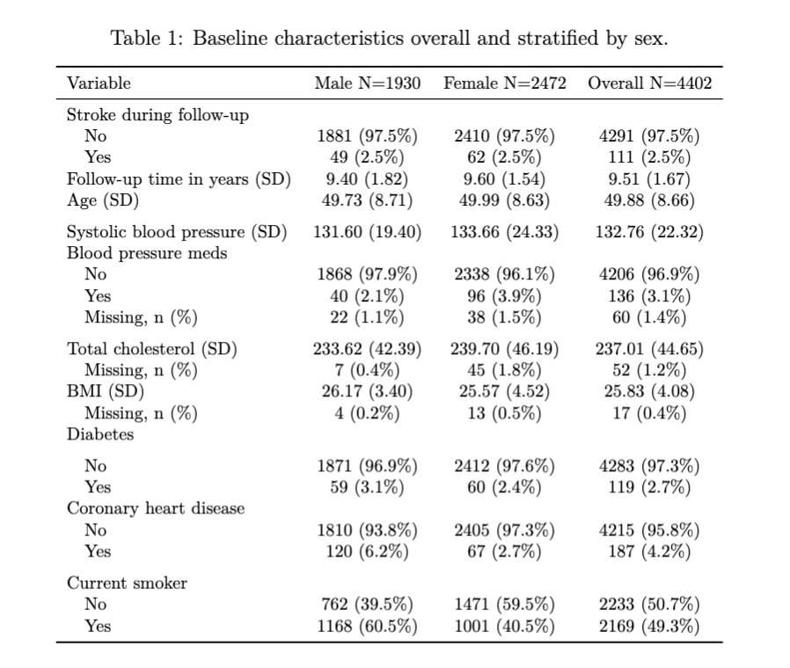
Data Overview
Initial dataset: 11,627
Primary analysis, exclude dataset to first examination period (4,434 participants)
Exclude participants with prevalent stroke at baseline (4,402)
Mean age: 50 years
Stroke incidence: 2.5%
Minimal missingness (~3%)
Notes:
The dataset initially included 11,627 observations across three exam periods.
For the primary analysis, I restricted the dataset to baseline measurements from the first exam, resulting in 4,434 participants.
After excluding individuals with prevalent stroke at baseline, the final sample included 4,402 participants.
The mean age was about 50 years, and the 10-year stroke incidence was relatively low at 2.5%.
Missingness was minimal, around 3%, so a complete-case analysis was used.
Overall, the dataset was fairly clean and appropriate for survival analysis.

Slide 4
Analysis
Cox proportional hazards model
Separate models for males and females
Forced variables: Age, diabetes, systolic blood pressure
Variable selection
Backward selection using AIC
Candidates: CHD, BP meds, smoking, cholesterol, BMI
Risk estimation: 10-year probability = 1-S(10)
Diagnostics: Schoenfeld residuals to test PH assumption
Notes:
To analyze the data, I used Cox proportional hazards models, which are appropriate for time-to-event outcomes.
Models were fit separately for males and females to allow for potential differences in risk factors.
Age, diabetes, and systolic blood pressure were included in all models a priori due to their strong clinical importance.
Additional variables were selected using backward selection based on AIC, considering coronary heart disease, blood pressure medication use, smoking, cholesterol, and BMI.
To estimate risk, I calculated 10-year stroke probabilities using the survival function from the fitted models.
Finally, I assessed the proportional hazards assumption using Schoenfeld residuals, and there was no evidence of violation.

Slide 5
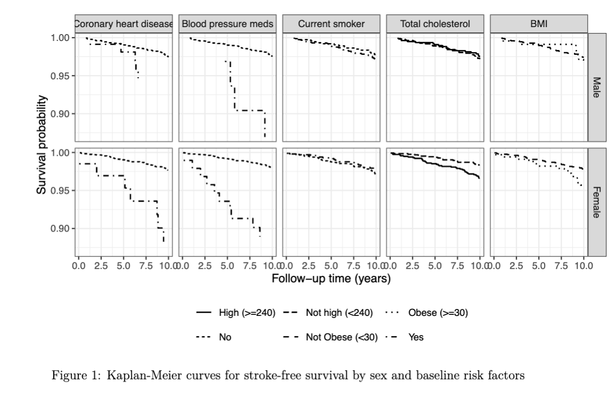
Descriptive Results
Stroke incidence low (2.5%)
Risk increases with age, blood pressure, and diabetes
Lower survival for CHD and BP med use
Minimal separation for smokers
Notes:
Descriptively, stroke incidence was low at 2.5%, which is important to keep in mind when interpreting results.
From the Kaplan-Meier curves, we see that stroke risk increases with age, systolic blood pressure, and diabetes.
Individuals with coronary heart disease and those using blood pressure medications showed lower stroke-free survival over time.
Interestingly, smoking showed minimal separation in survival curves, especially among males.
Overall, these patterns suggest that traditional cardiovascular risk factors are driving stroke risk in this cohort.

Slide 6
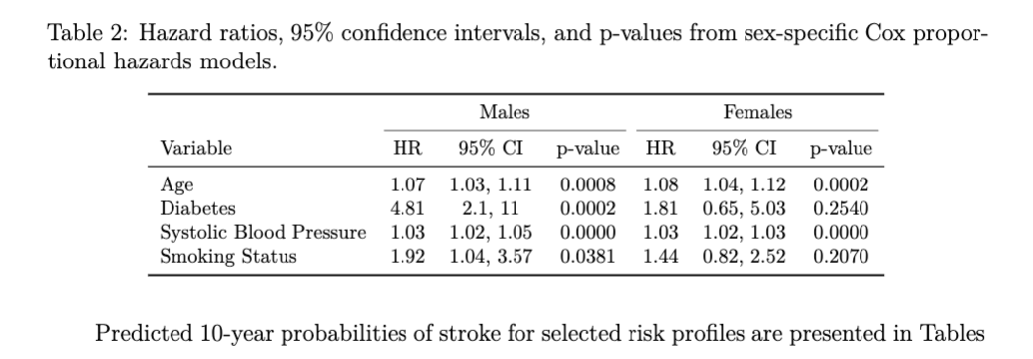
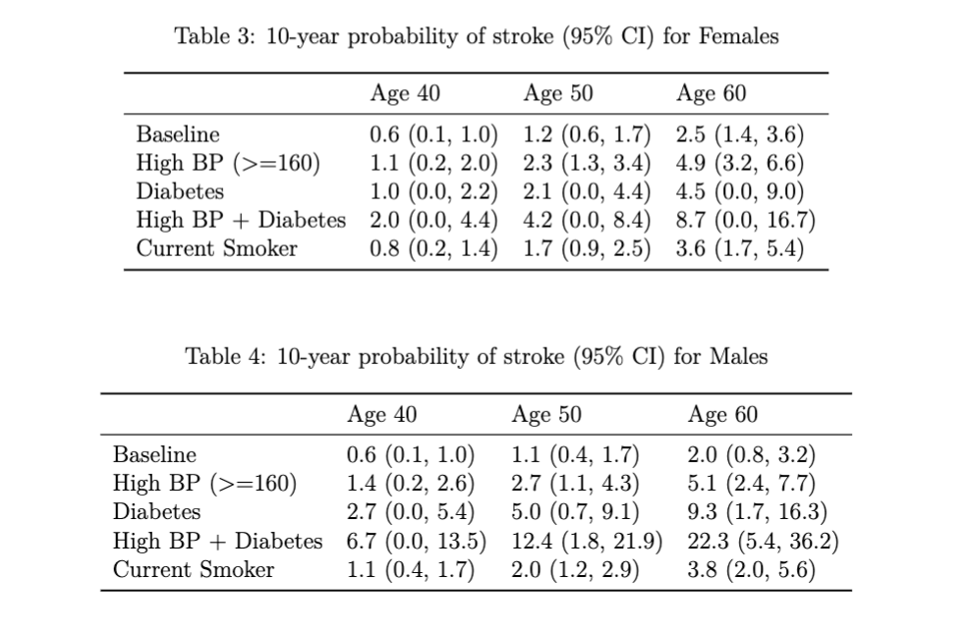
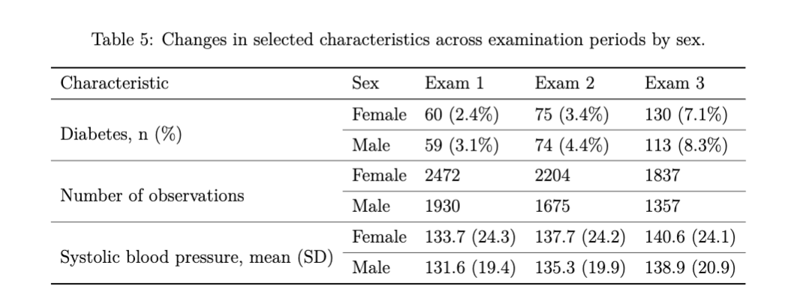
Model Results
Higher risk of stroke with increase in age and SBP for both sexes
Strong effect of diabetes in males (HR = 4.8) but not significant in females
Smoking significant for males only
Risk increases as Age goes from 40 to 60
Highest risk is found with High BP + Diabetes especially in males (~22%)
Diabetes status and SBP increases as time progresses in study for both males and females
Notes:
Looking at the model results, age and systolic blood pressure were significant predictors of stroke in both males and females.
For example, each additional year of age was associated with about a 6 to 8 percent increase in stroke hazard.
Diabetes showed the strongest association among males, with a hazard ratio of about 4.8, indicating nearly a five-fold increase in risk.
However, diabetes was not statistically significant among females, although the effect was still in the expected direction.
Smoking was also interesting — it was significant in males but not in females, suggesting possible sex differences in its effect.
When translating these results into predicted probabilities, we see that stroke risk increases substantially with age and accumulation of risk factors.
The highest risk occurs in individuals with both high blood pressure and diabetes.
For example, among males at age 60, the predicted 10-year stroke risk reached about 22%, which is much higher than baseline risk.
Finally, the longitudinal analysis showed that both diabetes prevalence and systolic blood pressure increased over time in both sexes, suggesting that risk factors worsen as the cohort ages.

Slide 7
Discussion
Main conclusions:
Age and systolic BP are consistent predictors
Diabetes is strongest risk factor especially for males
Combined risk factors (High BP+Diabetes) have largest increase in stroke probability
Limitations
Young cohort (mean age ~50 so low stroke incidence)
Limited power (few events)
Baseline-only covariates
AIC selection may be unstable and data-driven
Future Work:
Older populations
Time-varying models
More robust variable selection
Notes:
In summary, age and systolic blood pressure were consistent predictors of stroke across both sexes, and diabetes was the strongest risk factor, particularly among males.
The combination of high blood pressure and diabetes resulted in the largest increases in predicted stroke risk.
There are several important limitations to consider.
First, the cohort is relatively young, with a mean age of 50, which likely explains the low stroke incidence and limits statistical power.
Second, the analysis used baseline covariates only, even though risk factors such as diabetes and blood pressure increased over time.
Third, backward selection using AIC is a simple, data-driven method and may produce unstable results.
For future work, it would be useful to analyze older populations, incorporate time-varying covariates, and use more robust variable selection methods.
Overall, this analysis highlights the importance of cardiovascular risk factors in predicting stroke and demonstrates how risk increases with both age and the accumulation of these factors.

